Slide 1
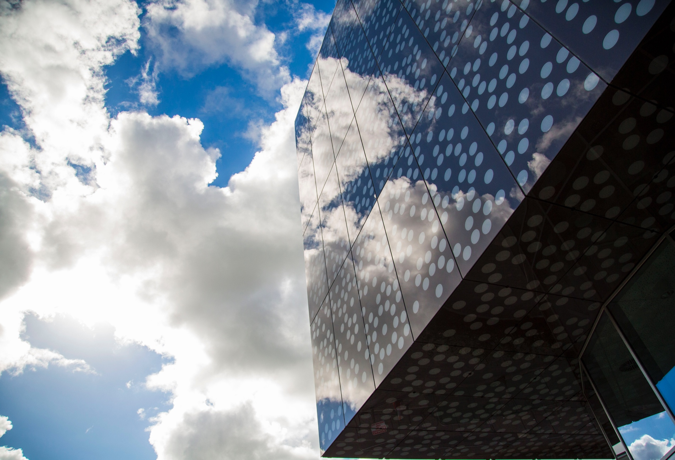
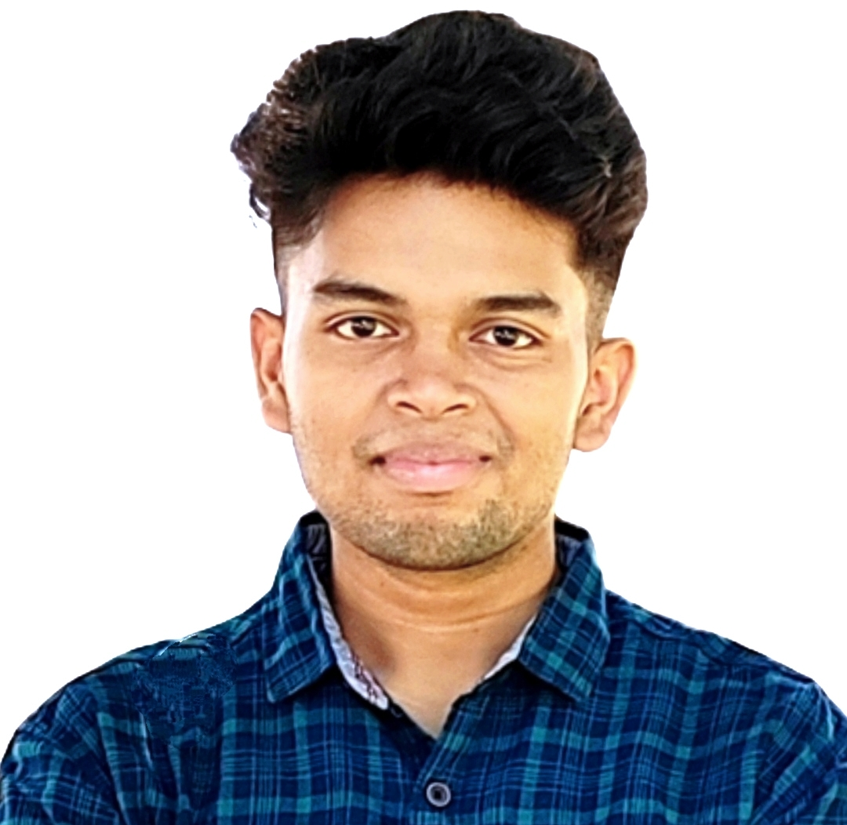
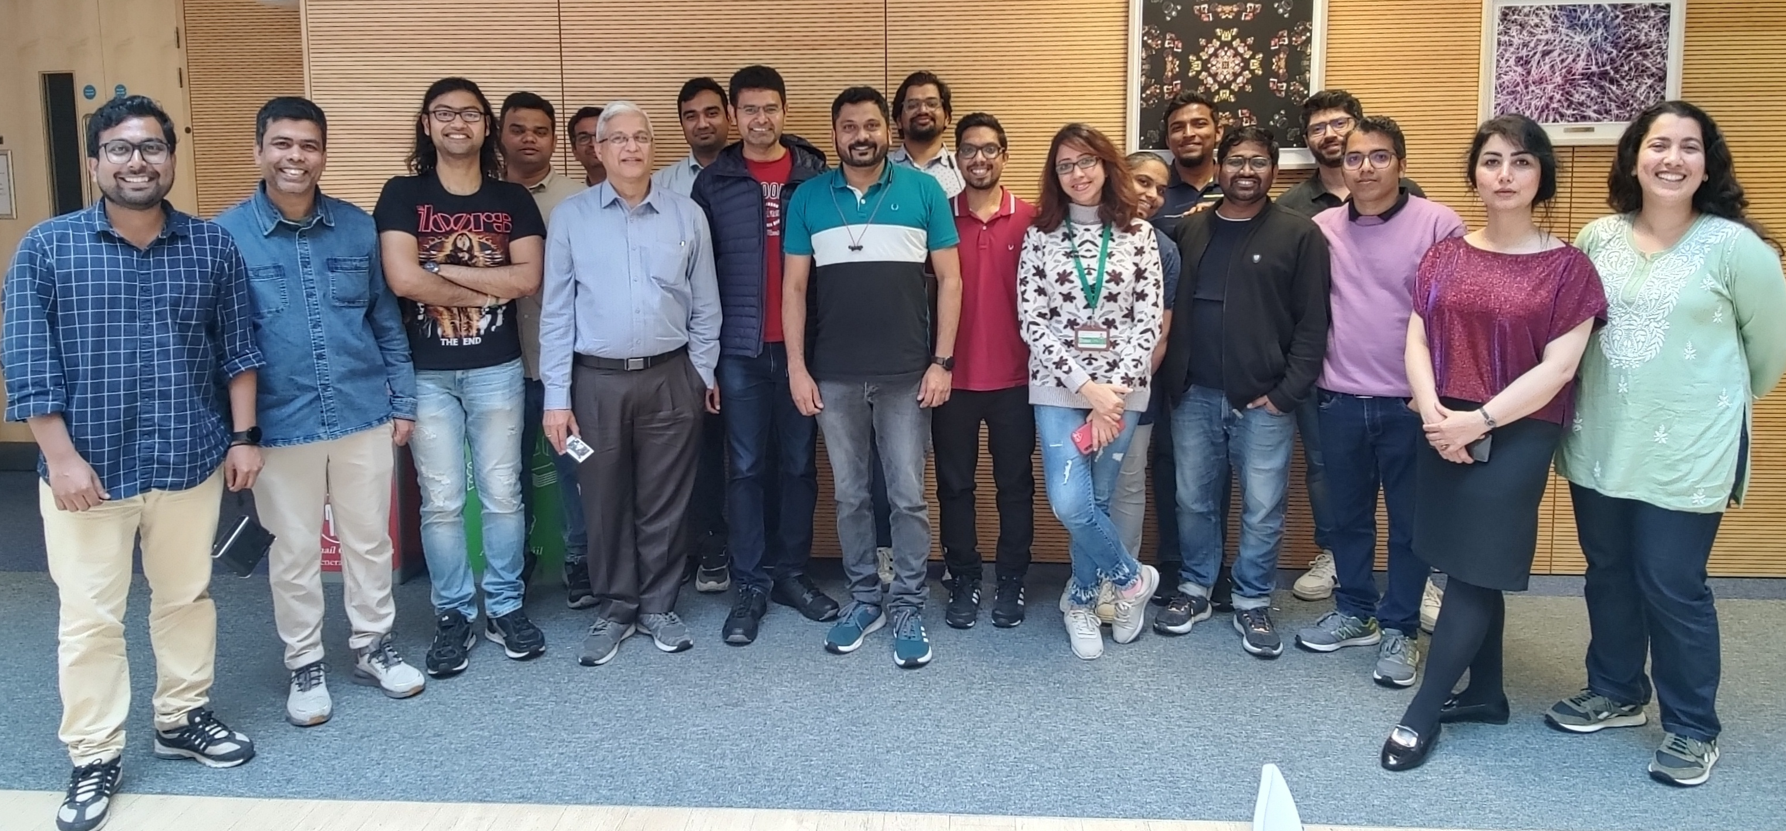
DC5: Improving mixing, nucleation, seed activation and CSD in crystallisers using HC
Induction School at University of Limerick: Monday, 23rd September 2024
Subhrajit Swain
University of Limerick
Subhrajit.Swain@ul.ie
Supervisor: Prof. Vivek V. Ranade
MRING @ UL

Slide 2
My journey so far…
Brief introduction and bio
Academic background
The journey so far - Past experiences

Slide 3
What I’ll be working on…
WP involvement
Key responsibilities

Slide 4
Looking forward and beyond the lab
Personal hobbies
Goals and aspirations
Let’s embark on this journey together

